Slide 1


Department of Computer Science and Engineering
CS19643 – FOUNDATIONS OF MACHINE LEARNING
PLANT DISEASE DETECTION
Abitha M
210701011
Aditi S 210701016
Dr.S. Vinodkumar
Professor

Slide 2
Abstract
This project explores the use of convolutional neural networks (CNNs) for automated plant disease detection through leaf image analysis. By training a CNN on a diverse dataset of healthy and diseased leaf images, the model achieves high accuracy in identifying various plant diseases. The system incorporates image preprocessing, dataset preparation, and model training and evaluation modules to ensure robustness and reliability. A user-friendly interface allows for real-time disease diagnosis, facilitating proactive agricultural management. This approach aims to enhance crop health monitoring, providing farmers with an efficient tool to improve yield and sustainability in agricultural practices.

Slide 3
Existing System
The existing systems for plant disease detection primarily rely on manual inspection and traditional image processing techniques. These methods involve visual assessment by agricultural experts, which can be time-consuming, subjective, and prone to errors, especially under large-scale farming conditions. Traditional image processing approaches use hand-crafted features and classical machine learning algorithms to identify disease symptoms, but they often lack the robustness and accuracy needed for diverse and complex agricultural environments. Additionally, these systems may struggle with variations in lighting, leaf orientation, and background noise, limiting their effectiveness. While some progress has been made with basic automated systems, there remains a significant gap in achieving high accuracy and scalability.

Slide 4
Proposed System
The proposed system leverages advanced convolutional neural networks (CNNs) to automate and enhance the accuracy of plant disease detection through leaf image analysis. Unlike traditional methods, this system uses deep learning to learn intricate patterns and features from a vast dataset of healthy and diseased leaf images, significantly improving diagnostic accuracy and robustness. The system is designed with multiple modules, including image preprocessing for standardized inputs, dataset preparation for diverse and comprehensive training data, and model training and evaluation to ensure high performance and reliability. A user-friendly interface allows farmers to easily upload images and receive real-time diagnoses, facilitating proactive disease management. The deployment module ensures seamless integration into various agricultural settings, emphasizing scalability, reliability, and ease of use.

Slide 5
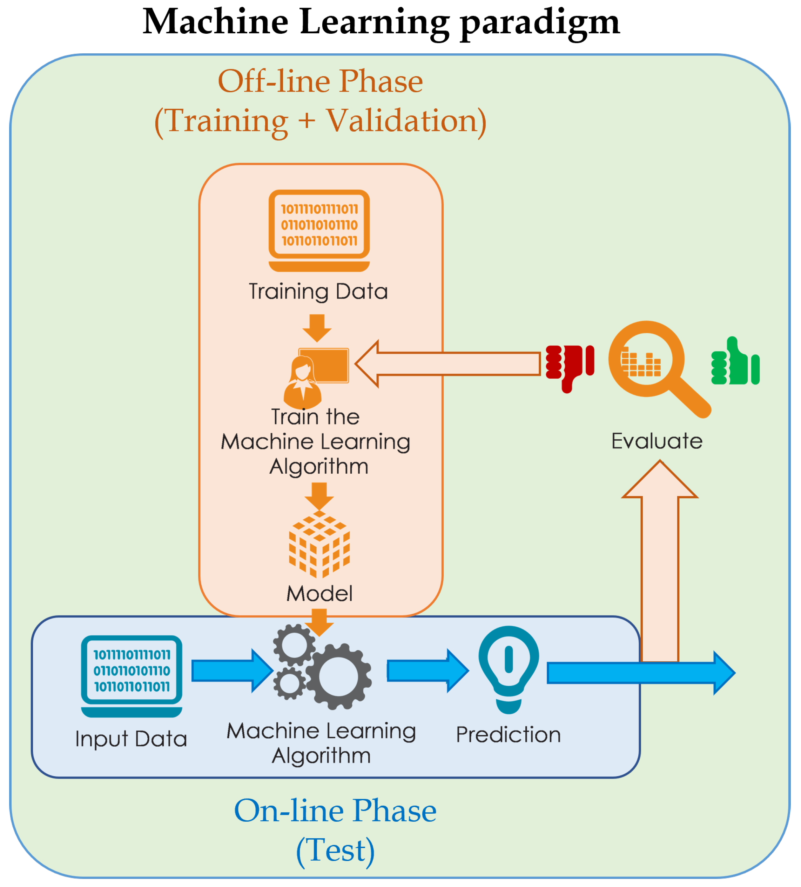
System Architecture

Slide 6
List of Modules
Image Preprocessing Module
Dataset Preparation Module
Convolutional Neural Network (CNN) Model Architecture
Model Training Module
Model Evaluation Module
User Interface Module

Slide 7
Functional Description for each modules
Image Preprocessing Module: This module is responsible for preprocessing the raw leaf images before feeding them into the neural network model. Preprocessing steps may include resizing, normalization, noise reduction, and color correction to enhance the quality and consistency of the input images.

Slide 8
Functional Description of Module
Dataset Preparation Module: This module involves the collection, organization, and preprocessing of the dataset used for training and evaluation. It includes tasks such as data augmentation to increase the diversity of the dataset, splitting the dataset into training, validation, and testing sets, and ensuring balanced distribution of samples across different classes (healthy and diseased).

Slide 9
Functional Description of Module
Convolutional Neural Network (CNN) Model Architecture: The heart of the project, this module defines the architecture of the CNN model used for plant disease detection. It includes layers such as convolutional layers, pooling layers, and fully connected layers. The architecture may be customized based on the specific requirements of the project and the characteristics of the dataset.

Slide 10
Functional Description of Module
Model Training Module: This module is responsible for training the CNN model using the prepared dataset. It involves configuring training hyperparameters, such as learning rate and batch size, and optimizing the model parameters using backpropagation and gradient descent algorithms. Transfer learning techniques may also be employed to leverage pre-trained models for improved performance.

Slide 11
Functional Description of Module
Model Evaluation Module:After training, this module evaluates the performance of the trained model on the validation and testing datasets. Evaluation metrics such as accuracy, precision, recall, and F1 score are computed to assess the model's effectiveness in disease detection and classification. The module also includes techniques for visualizing model predictions and identifying areas for improvement.

Slide 12
Functional Description of Module
User Interface Module: This module provides a user-friendly interface for interacting with the plant disease detection system. It allows users to upload leaf images through a web or mobile interface and provides real-time feedback on disease diagnosis and recommended management strategies. The interface may also include features for data visualization, model selection, and performance monitoring.

Slide 13
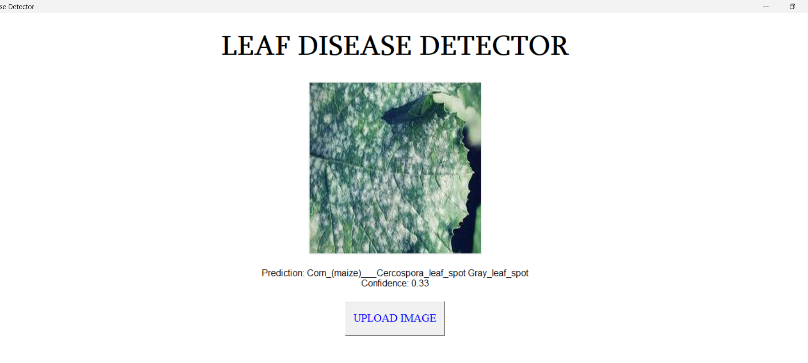
Output

Slide 14
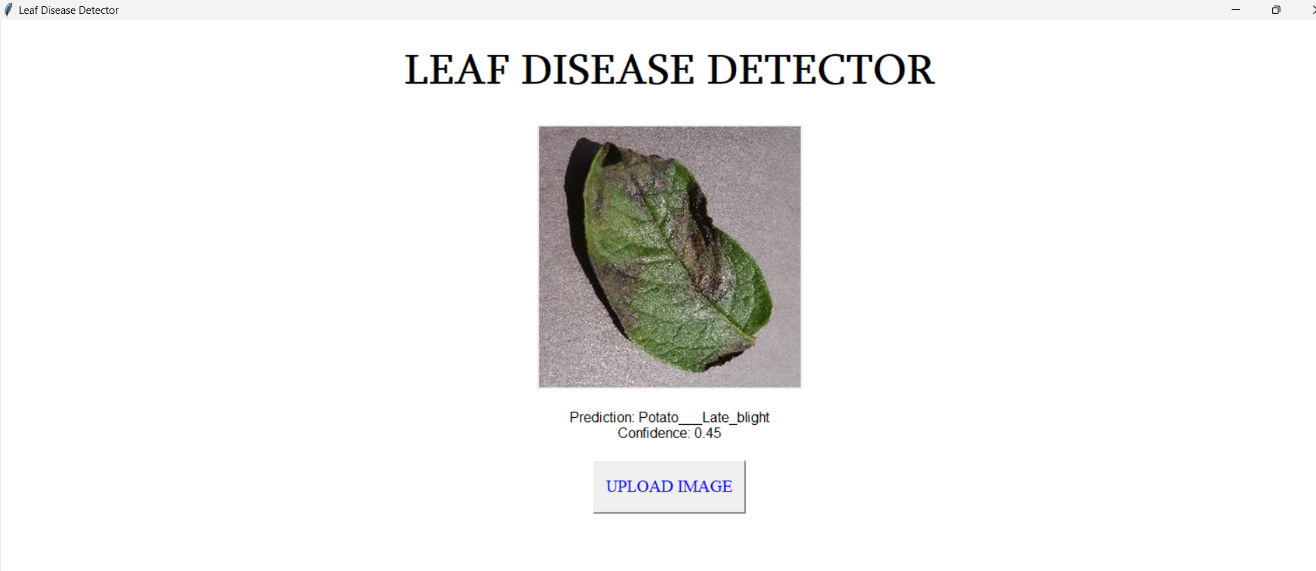
Output

Slide 15
References
Mohanty, S. P., Hughes, D. P., & Salathé, M. (2016). Using deep learning for image-based plant disease detection. Frontiers in Plant Science, 7(September), [1419].https://doi.org/10.3389/fpls.2016.01419
Ser Serawork Wallelign, Mihai Polceanu, Cédric Buche. Soybean Plant Disease Identification Using Convolutional Neural Network. FLAIRS-31, May 2018, Melbourne, United States. https://hal.archives-ouvertes.fr/hal-01807760
S.Arivazhagan, R. Newlin Shebiah, S.Ananthi, S.Vishnu Varthini. 2013. Detection of unhealthy region of plant leaves and classification of plant leaf diseases using texture features. Agric Eng Int: CIGR Journal.
Huu Quan Cap, Katsumasa Suwa, Erika Fujita, Satoshi Kagiwada, Hiroyuki Uga, and Hitoshi Iyatomi. A deep learning approach for on-site plant leaf detection. 2018 IEEE 14th International Colloquium on Signal Processing & Its Applications (CSPA).

Slide 16
References
Santhosh Kumar S, and B. K. Raghavendra. Diseases Detection of Various Plant Leaf Using Image Processing Techniques: A Review. 2019 5th International Conference on Advanced Computing & Communication Systems (ICACCS)
Jyotsna Bankar, and Nitin R Gavai. Convolutional Neural Network based Inception v3 Model for Animal Classification. International Journal of Advanced Research in Computer and communication Engineering, May 2018
Abirami Devaraj, Karunya Rathan, Sarvepalli Jaahnavi, and K Indira. Identification of Plant Disease using Image Processing Technique. 2019 International Conference on Communication and Signal Processing (ICCSP).
Mercelin Francis, and C. Deisy. Disease Detection and Classification in Agricultural Plants Using Convolutional Neural Networks .
S. Sankaran, A. Mishra, R. Ehsani, and C. Davis, ―A review of advanced techniques

Slide 17
Thank You

